Slide 1
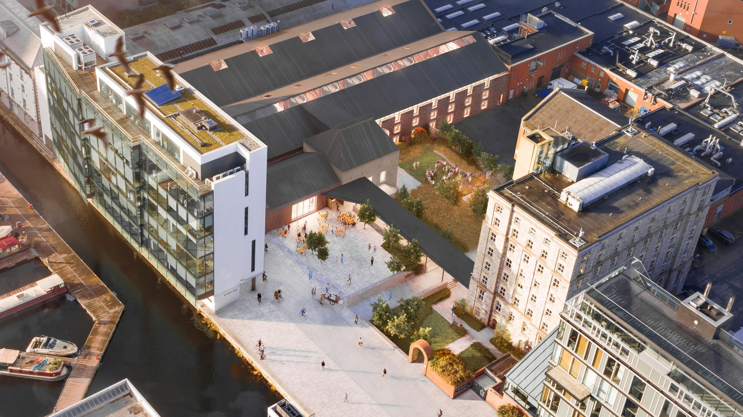


Welcome to
Trinity’s Innovation Community

Slide 2

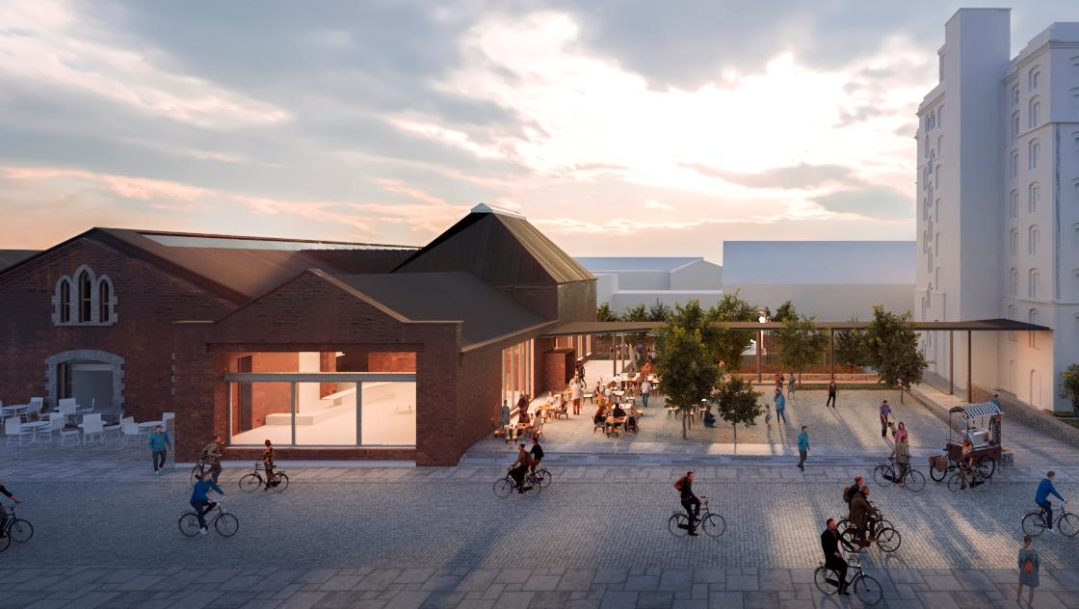
  CONTENTS
01
02
TRINITY INNOVATION HUB, TRINITY’S INNOVATION COMMUNITY
OUR VALUE PROPOSITION
03
04
PARTNERSHIP POSSIBILITIES
BUILDING THE FUTURE TOGETHER
  Building
  Trinity TRINITY INNOVATION HUB, Innovation & Enterprise
Trinity College Dublin, The University of Dublin

Slide 3
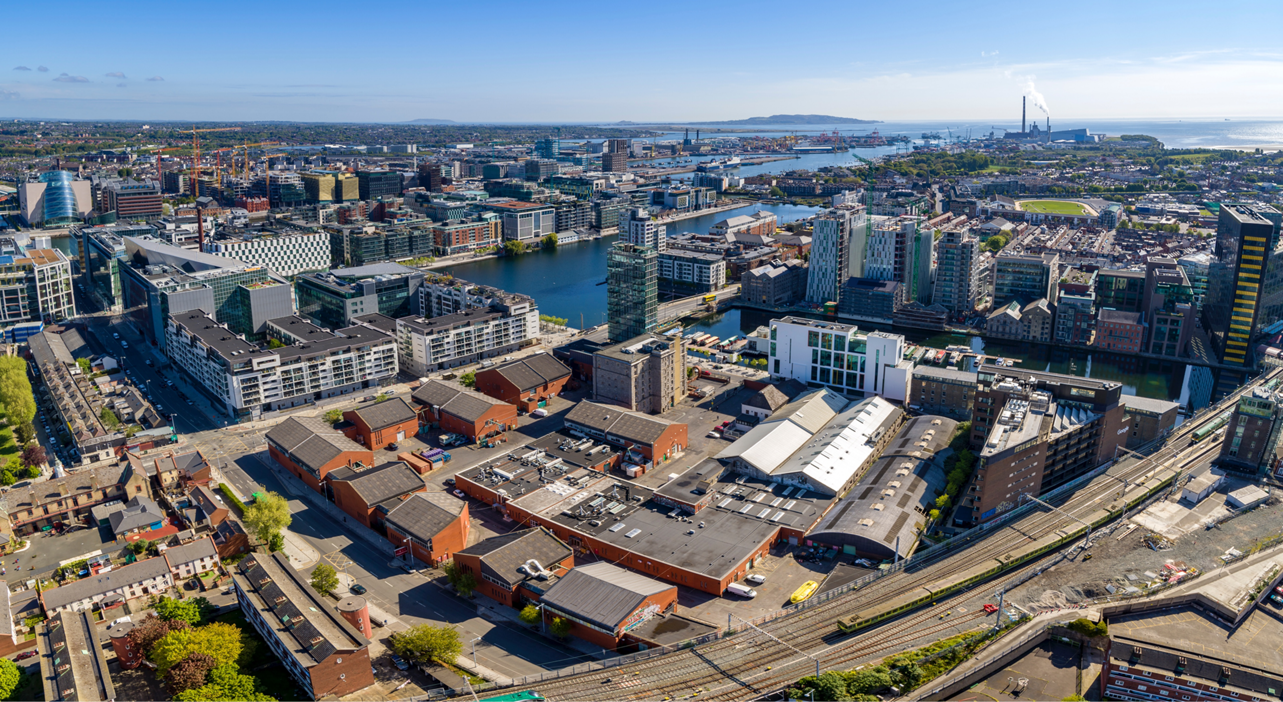
01
TRINITY INNOVATION HUB, TRINITY’S INNOVATION COMMUNITY
Trinity College Dublin, The University of Dublin

Slide 4
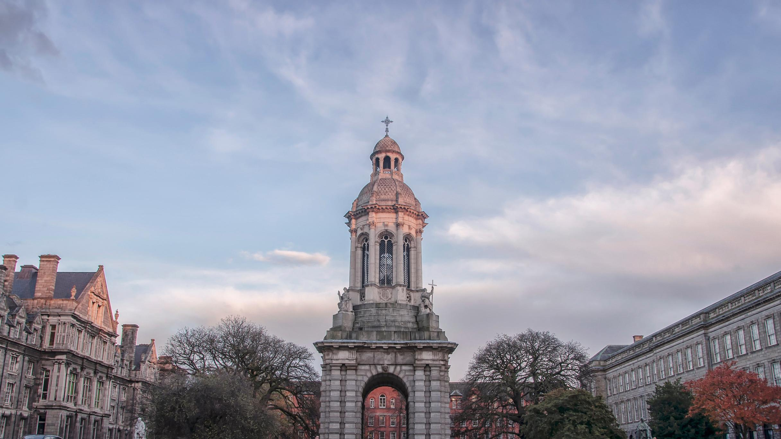
TRINITY INNOVATION HUB - INTENSIFYING INNOVATION
Programming
Trinity Business School
Innovation Hub
Grand Canal Dock
Event Spaces
At the heart of the university — supporting students, researchers, and Trinity partners.
Trinity College Dublin, The University of Dublin

Slide 5
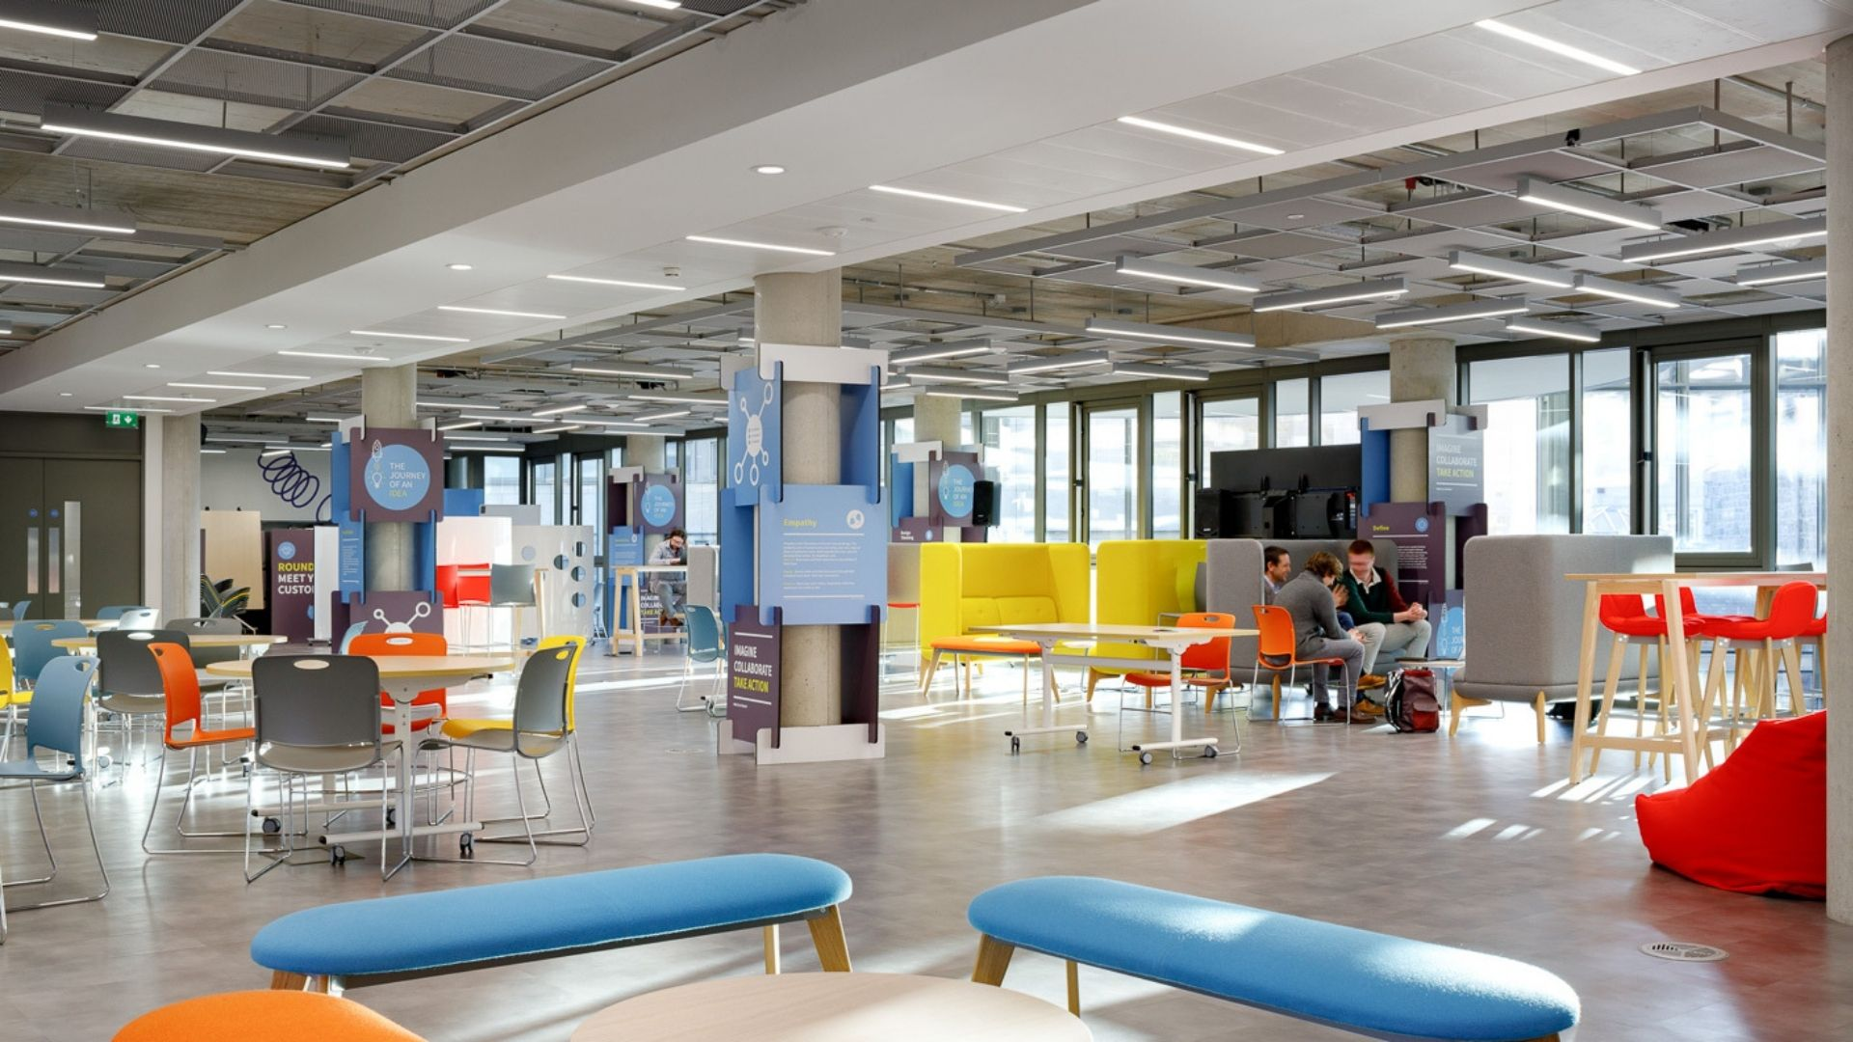
TRINITY INNOVATION HUB – INTENSIFYING INNOVATION
Programming
Education & Accelerator
Undergraduate
Postgraduate
PhD Researcher
Innovation Hub
Event Spaces
Trinity College Dublin, The University of Dublin

Slide 6
TRINITY INNOVATION HUB IS AN ACCESS POINT TO TRINITY COLLEGE DUBLIN
Innovation Hub
Programming
An innovation hub connected to the city — ideal for industry collaboration and external engagement.
Event Spaces
Trinity College Dublin, The University of Dublin

Slide 7
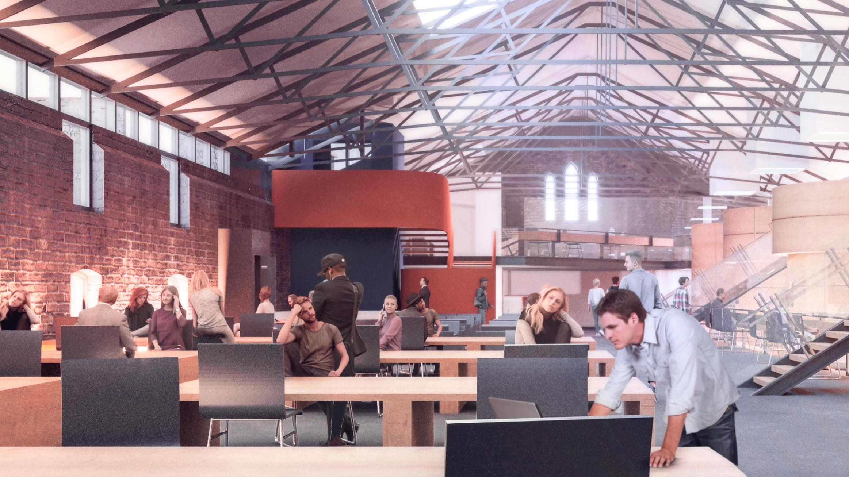
TRINITY INNOVATION HUB IS AN ACCESS POINT TO TRINITY COLLEGE DUBLIN
Event Spaces
Programming
Innovation Hub
At the heart of the university — supporting students, researchers, and Trinity partners.
Trinity College Dublin, The University of Dublin

Slide 8
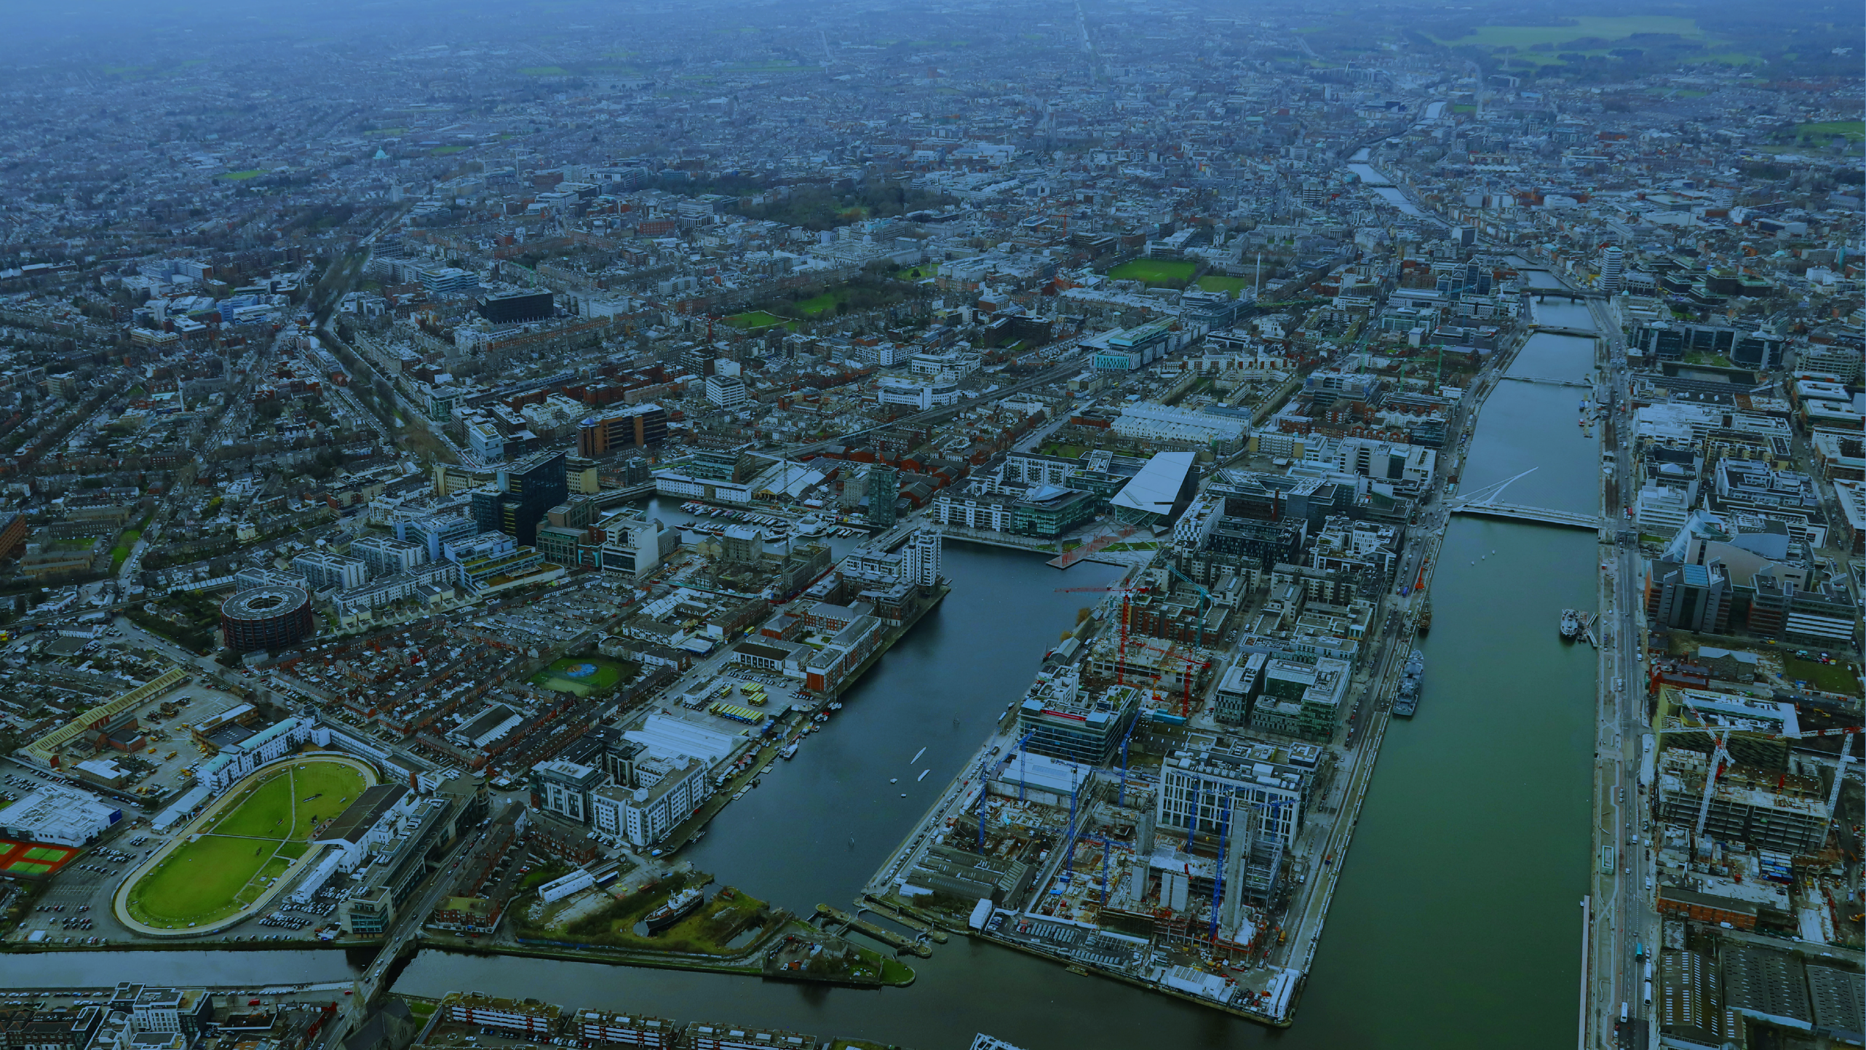
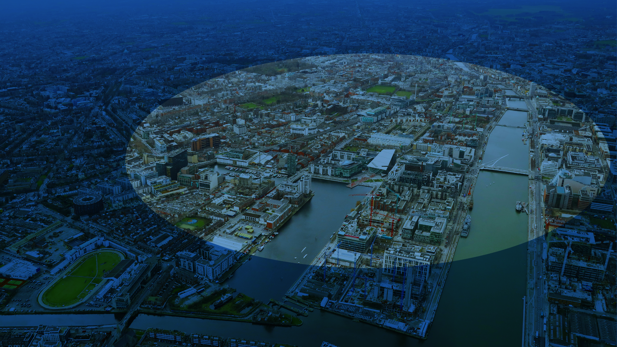
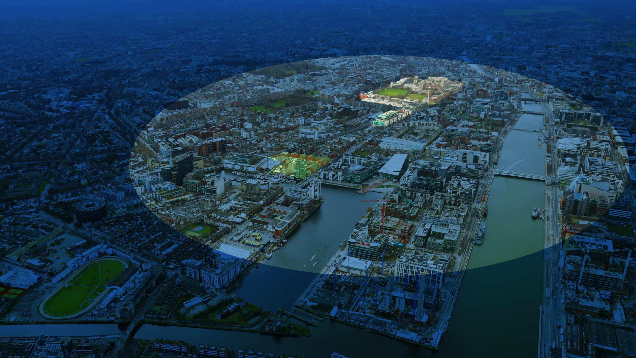
Trinity College Dublin
Trinity College Dublin, The University of Dublin

Slide 9
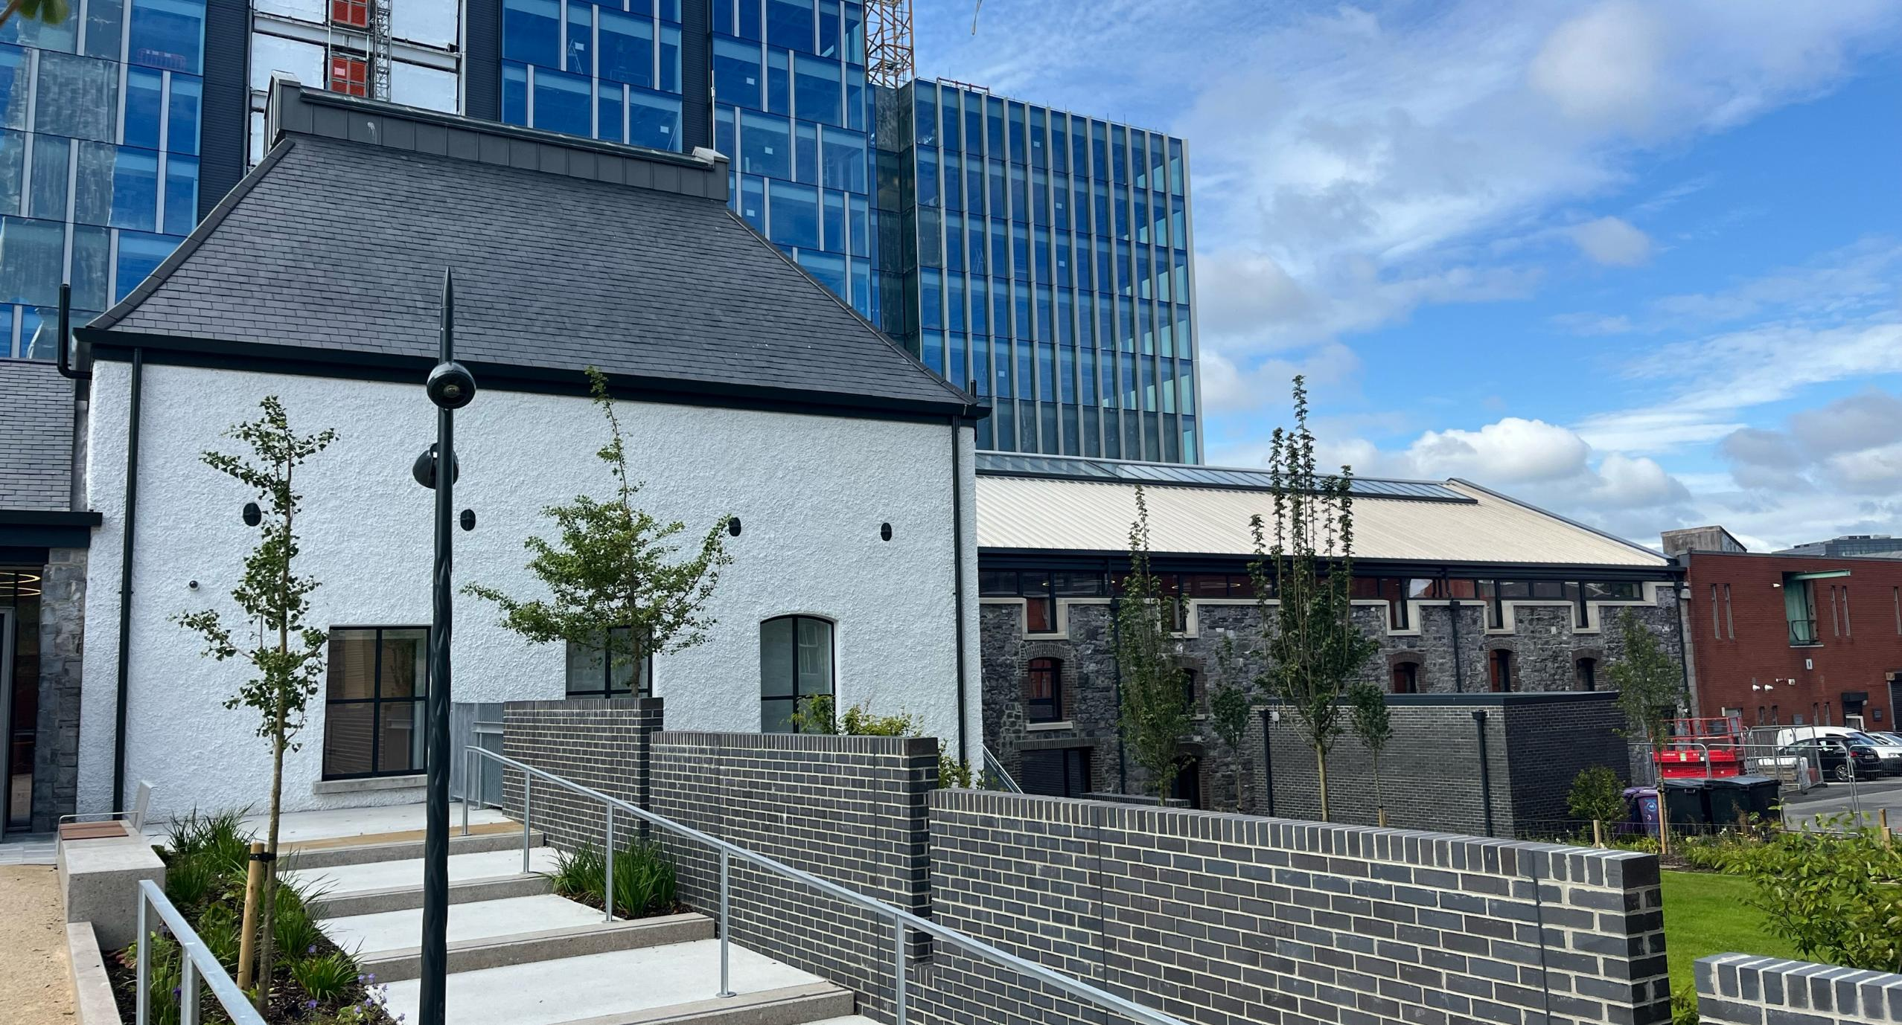
02
OUR VALUE PROPOSITION
Trinity College Dublin, The University of Dublin

Slide 10

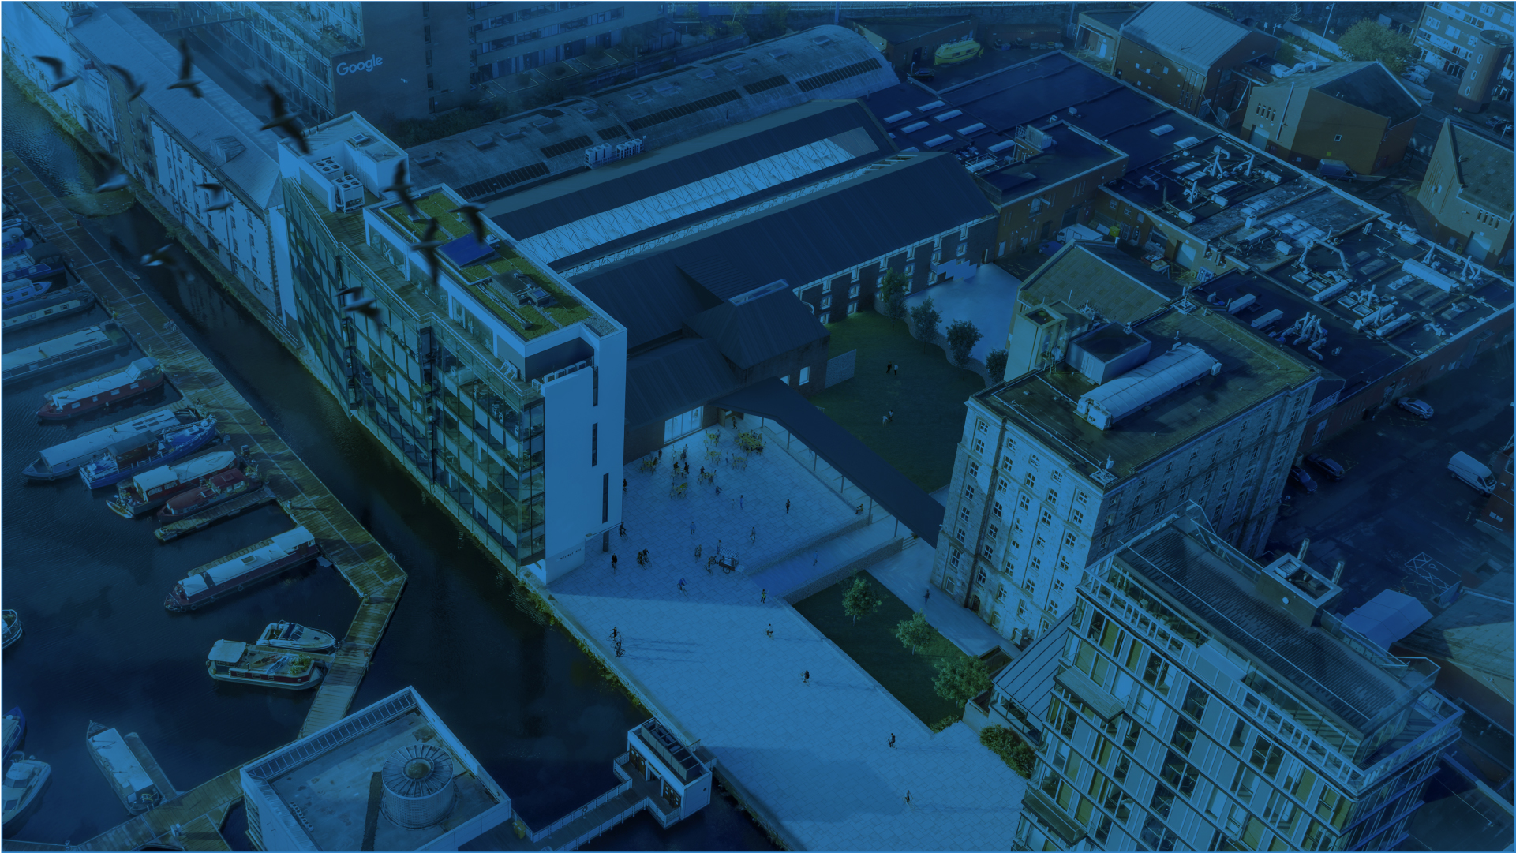
Academia/Thought Leaders
Corporates / Multinationals
Startups & Scale-ups
TRINITY INNOVATION HUB unlocks value for all our partners in the innovation ecosystem
Trinity College Dublin, The University of Dublin
VCs & Investors
Professional Services
Public Agencies & Nonprofits

Slide 11

OUR VALUE PROPOSITION
Academia/Thought Leaders
SME / MNC
Startups & Scale-ups
Collaborate on research, policy, and education initiatives that drive societal and economic impact.
Co-develop solutions with research teams; access talent & boost brand credibility. Connect with the innovation community.
Access workspace, community, interns, support to kick-start and accelerate your business.
VCs & Investors
Professional Services
Public Agencies & Nonprofits
Connect with spinouts & ventures; host demo days, curate opportunities.
Engage as innovation champions; enhance service visibility through insights & events.
Align with policy, students & social innovation for measurable impact.
Trinity College Dublin, The University of Dublin

Slide 12


AT TRINITY INNOVATION HUB PARTNERSHIPS ARE TAILORED TO YOUR NEEDS
Collaborative Research
Consultancy
Knowledge Transfer
New Ventures Supports
Collaborate on research, policy, and education initiatives that drive societal and economic impact.
Get expert advice and innovation support from Trinity specialists.
Access contracts and tech transfer services for knowledge exchange.
Support entrepreneurship through pitch and demo day programmes.
Talent
Education
Philanthropy
Branding & Identity
Connect with future-ready graduates via events, hackathons, and mentoring.
Join knowledge-sharing events and build community with Trinity.
Support purpose-led initiatives through funding or CSR partnerships.
Place your brand at the centre of Ireland’s innovation ecosystem.
Trinity College Dublin, The University of Dublin

Slide 13
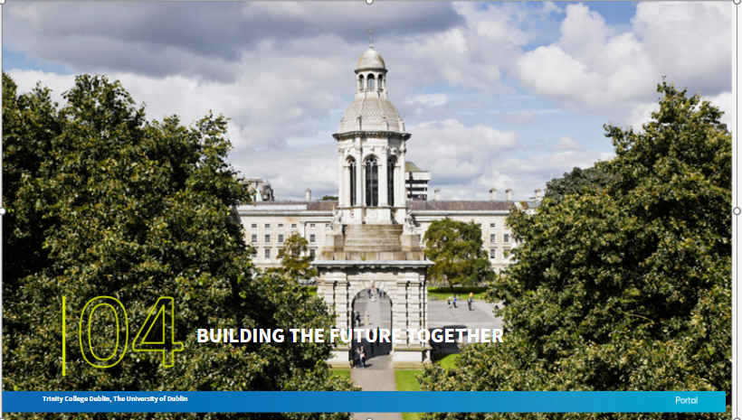

Slide 14
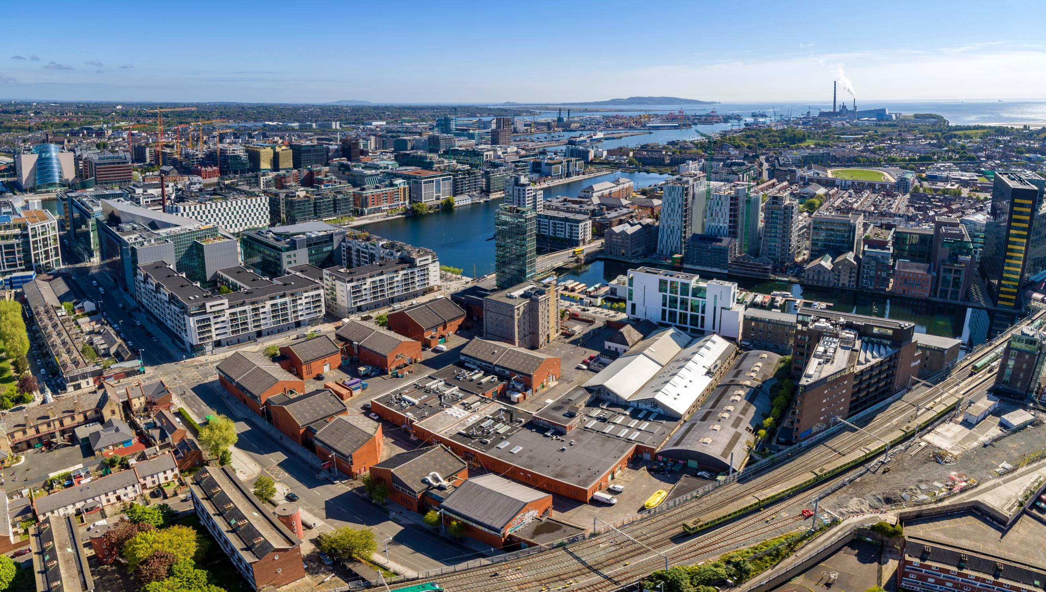

BUILDING THE FUTURE TOGETHER
We will work with you to find areas of alignment of purpose and outcome, that positions your organisation as a significant partner in the entrepreneurship ecosystem.
We want to curate meaningful connections and partnerships that cultivate and build relationships across the Trinity Network
14
Trinity College Dublin, The University of Dublin

Slide 15
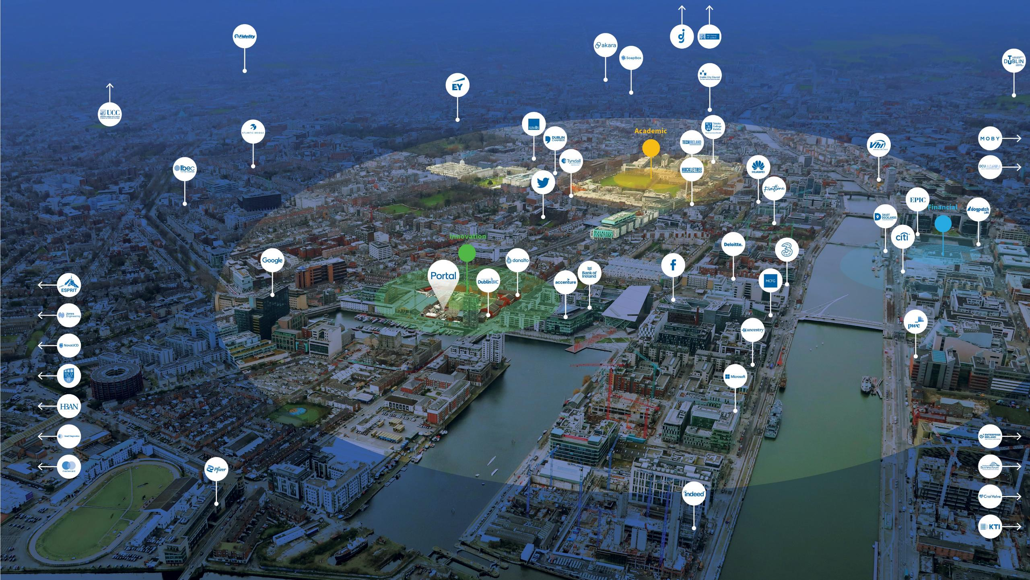
TRINITY INNOVATION HUB LOCATION
Heart of Trinity
At Trinity, with direct access to students, researchers, and academic networks.
Heart of Innovation
Connecting Worlds
At Grand Canal Dock, in the heart of Dublin’s tech and innovation district.
Connecting academia and industry through two high-impact locations.
Trinity College Dublin, The University of Dublin

Slide 16
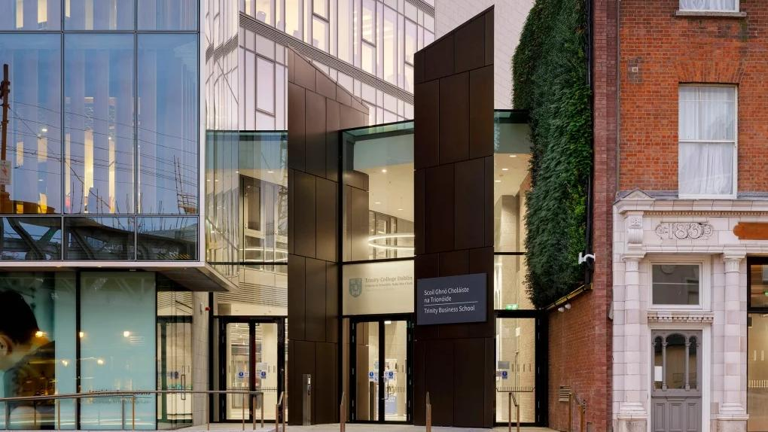

LET’S BUILD THE FUTURE TOGETHER.

